Slide 1
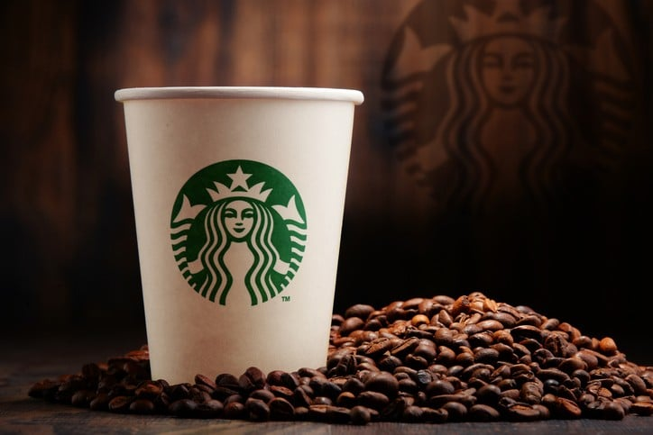
Starbucks Annual Business Metting
Brewing better business together
Presented by
Rajni Ranjan Prasad

Slide 2
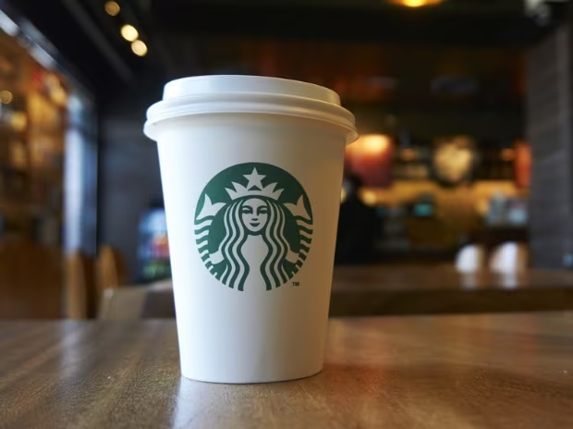
About Starbucks Annual growth
Your Coffee Your Way

Slide 3


Point to be discussed
Financial Performance
Market Analysis
Sales and Marketing Efforts
Product or Service Development
Future Outlook and Strategy

Slide 4
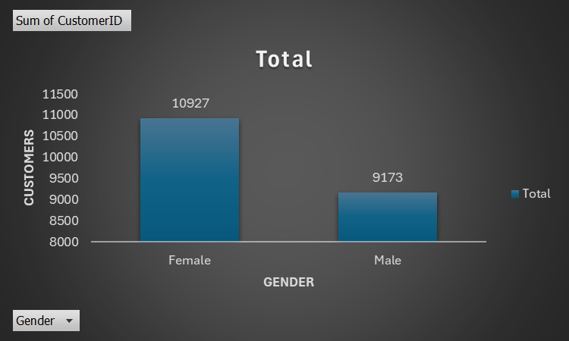
Gender Distribution of Customers
diverse customer base with significant representation from both males and females, reflecting broad appeal and inclusivity in market demographics

Slide 5
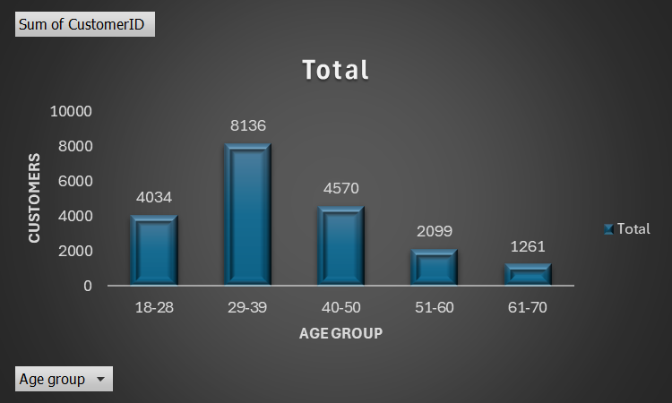
Age Distribution of Customers
redominant customer base aged 18-44, with a growing segment of older adults above 45 years

Slide 6
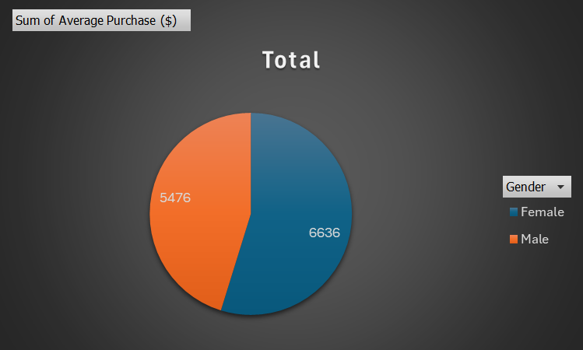
Average Purchase by Gender
On average, males and females spend similarly at Starbucks, reflecting equitable spending patterns across genders in coffee consumption

Slide 7
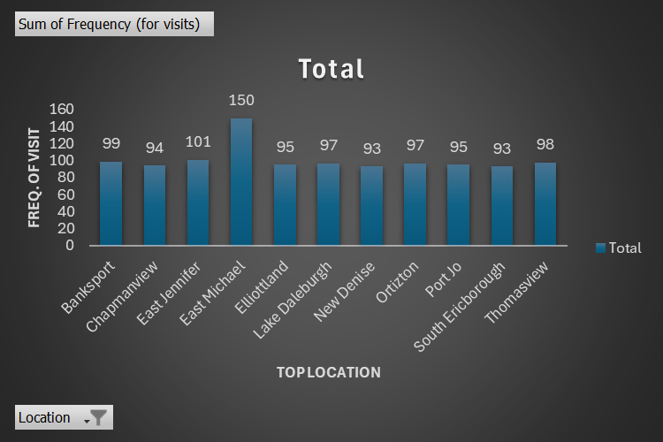
Frequency of Visits by Location
Starbucks locations typically see higher visit frequencies in urban and suburban areas compared to rural locales, driven by population density and accessibility

Slide 8
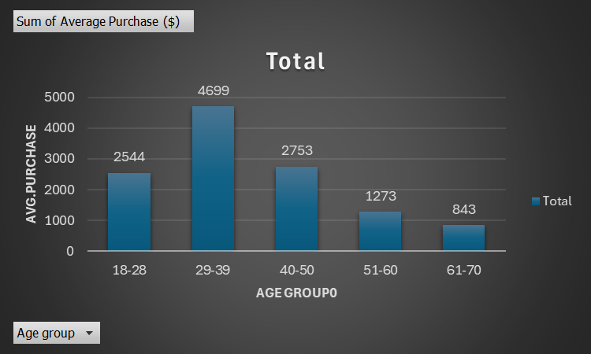
Average Purchase by Age Group
The average purchase at Starbucks varies by age group, with younger adults (18-40) often spending less than older adults (41-70) on average per visit

Slide 9
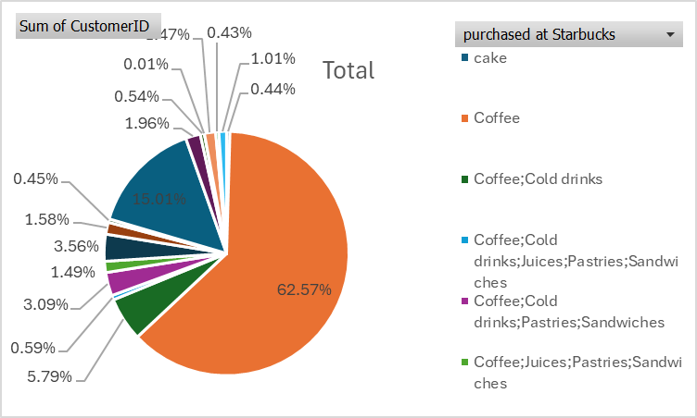
Percentage of Customers Who Purchased at Starbucks
Approximately 65% of Starbucks customers make purchases coffee during their visits, reflecting high engagement and conversion rates within the customer base.

Slide 10
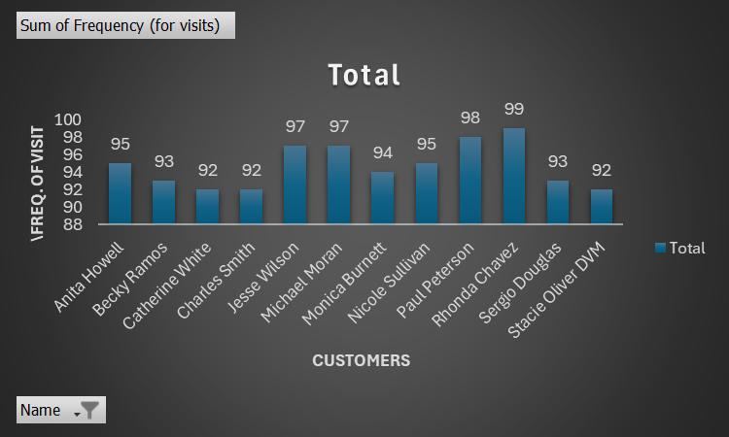
Customer Frequency Distribution
Customer frequency at Starbucks shows a majority visiting 1-3 times weekly, with a significant portion visiting daily, reflecting strong customer loyalty

Slide 11
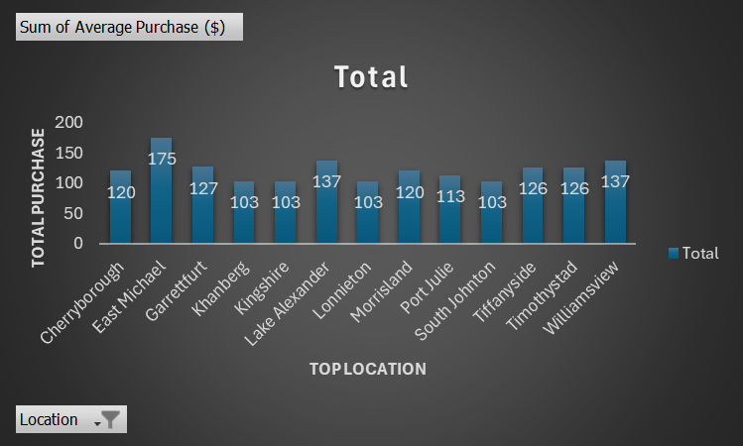
Top Locations by Total Purchases
Starbucks' top locations by total purchases include urban centers East Michael, Lake Alexander and Wlliamsview reflecting high consumer traffic and demand in densely populated areas.

Slide 12

Customer Age vs. Average Purchase
Younger customers (18-40) tend to make high average purchases compared to older
(40-60), reflecting varying spending habits by age group at Starbucks.

Slide 13
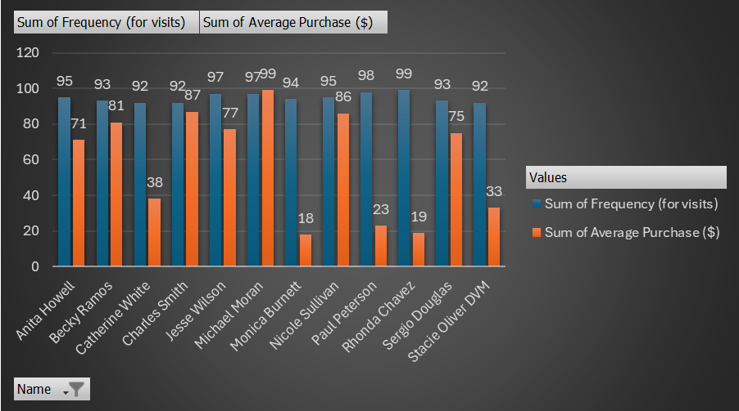
Frequency vs. Average Purchase
Higher frequency of visits generally correlates with lower average purchase amounts, suggesting varying spending patterns influenced by visit frequency at Starbucks.

Slide 14
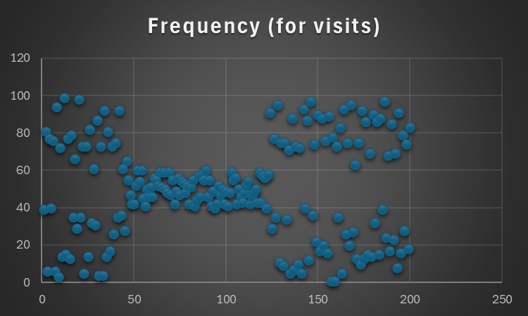
Customer Demographics Breakdown
Starbucks customer demographics show diverse age groups with a balanced gender distribution, reflecting broad appeal across various demographic segments

Slide 15
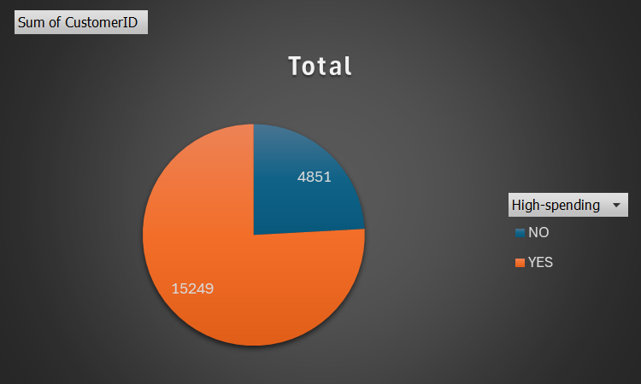
High-Spending Customers
High-spending customers at Starbucks typically include urban professionals, frequent visitors, and those who purchase specialty drinks or food items, contributing significantly to overall sales

Slide 16
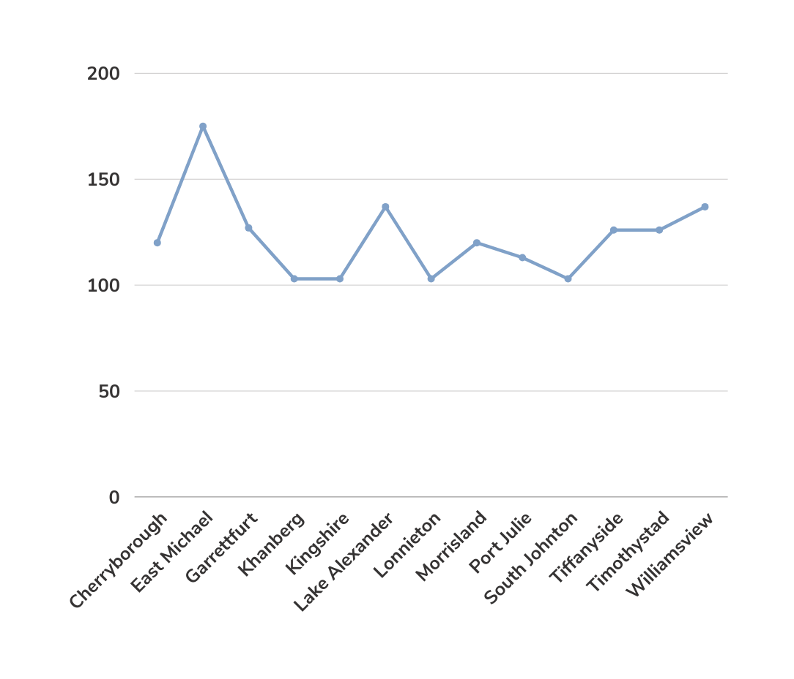
Annual Financial Performance
A look into Starbucks
Coffee House progress
Top Store sales over the past year
Visualize complicated and dense information with charts and graphs. These help people process and remember data quickly.

Slide 17
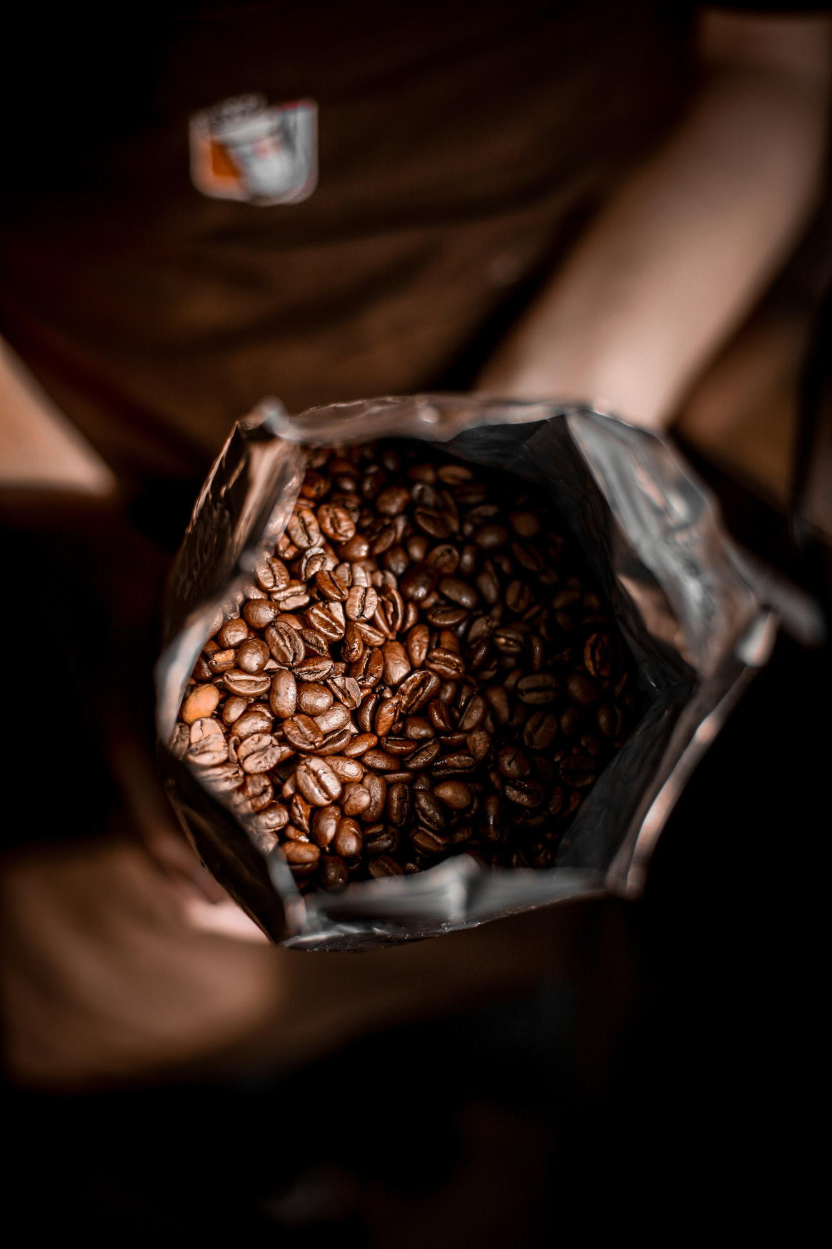
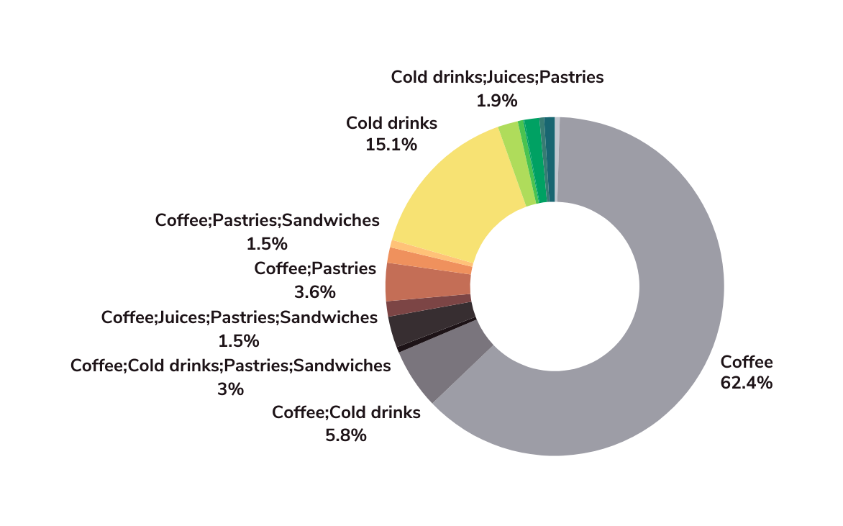
Annual Product Performance
How Starbucks Coffee House dominates the food industry
Our gross sales as compared
to other local coffee shops
Visualize complicated and dense information with charts and graphs. These help people process and remember data quickly.

Slide 18
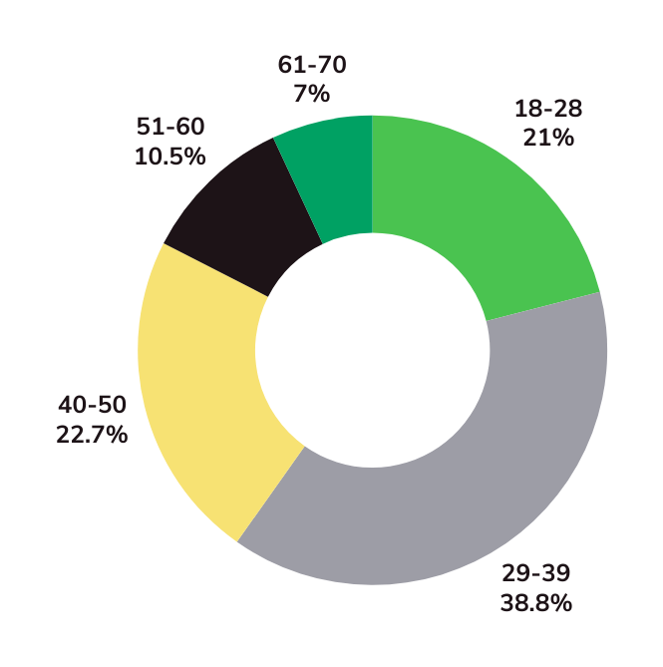
Customer Age vs. Average Purchase
Average Purchased by Age group
This chart will help us to understand what type of age group like our coffee and future Plan to increase our customers.

Slide 19



Target Customers
Youngsters
Busy Bees
Adults
18-28
38-48
28-38

Slide 20
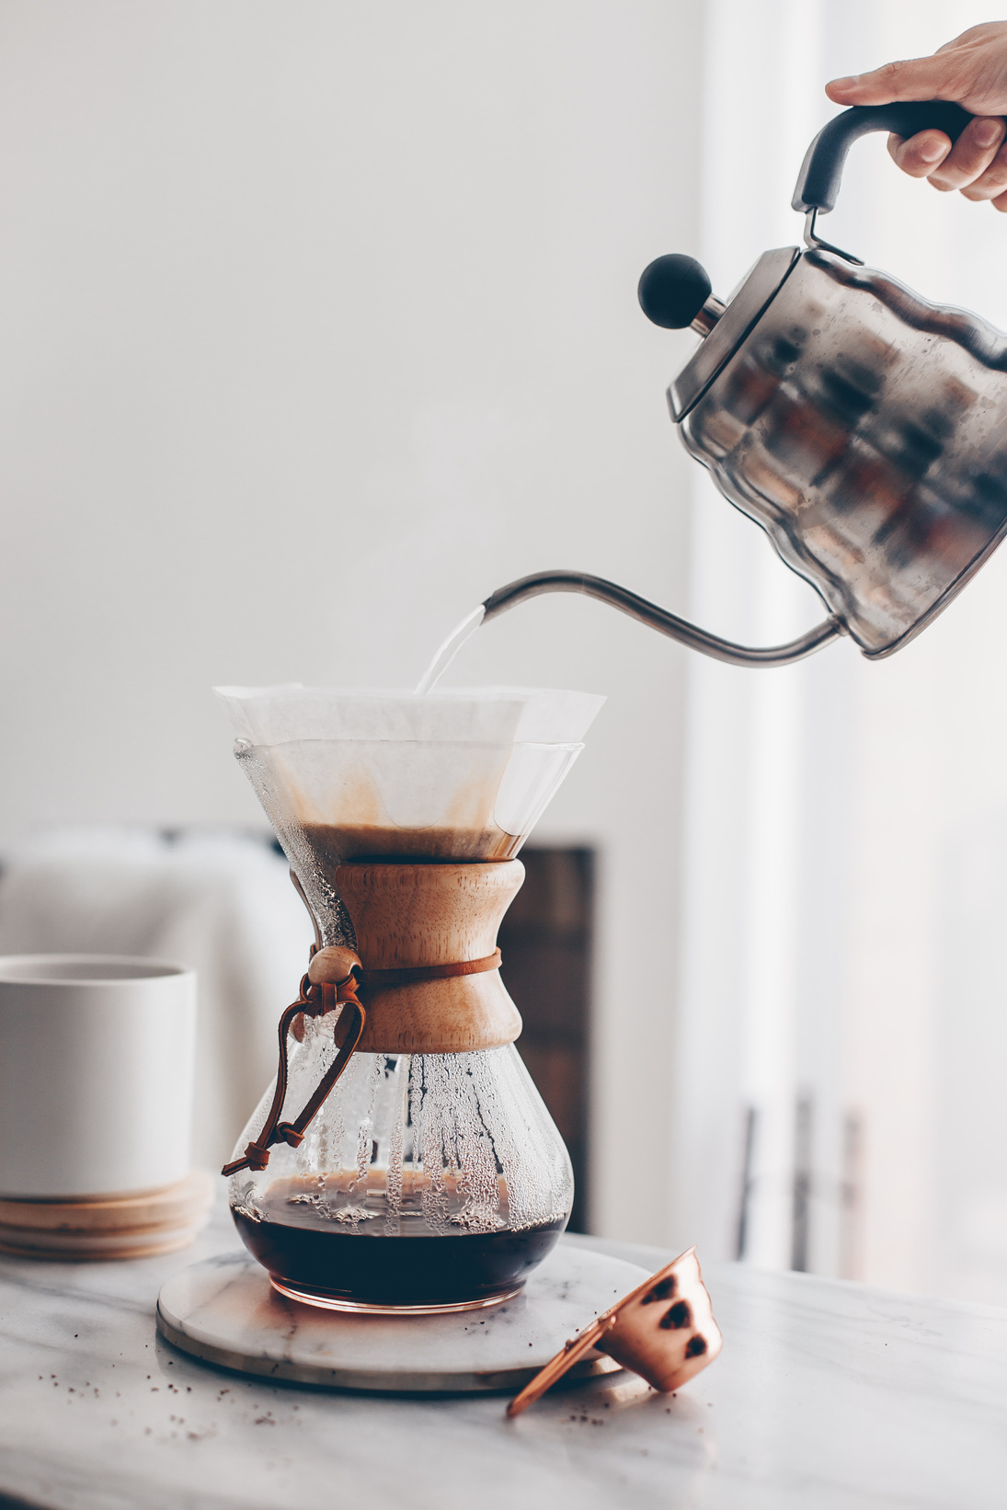
Awareness
Utilize AR experiences, micro-influencers, and community events to enhance Starbucks' brand awareness effectively
Future Marketing Strategy
Acquisition
Expand market reach through strategic partnerships, digital campaigns, and targeted customer acquisition initiatives
Activation
Drive engagement with personalized offers, interactive experiences, and community-driven activations to enhance brand loyalty

Slide 21

Marketing Strategy
Retention
Revenue
Referral
Engage with your audience too using Live Q&A.
Send surveys your audience can answer on their devices.
Finally, present like a pro using presenter view.

Slide 22
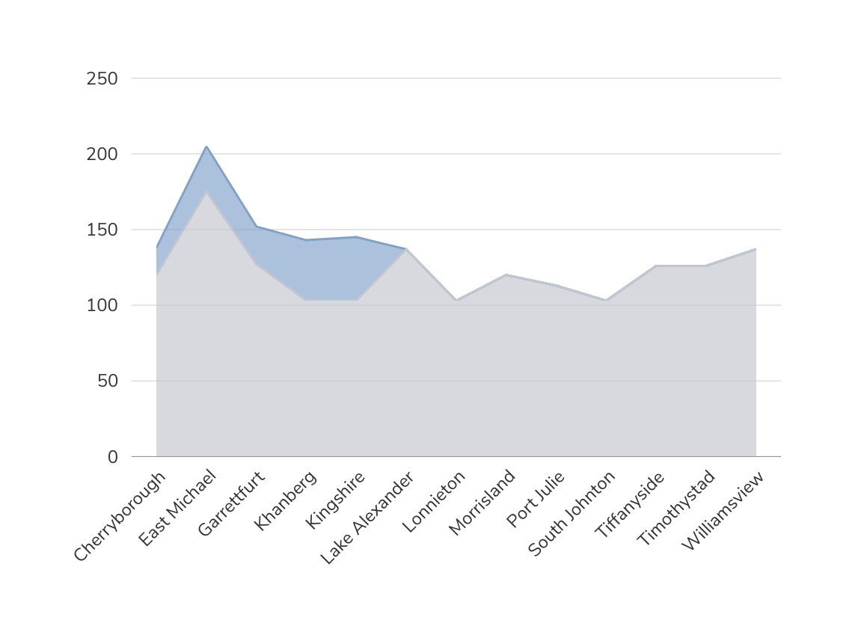
Predicted Business Growth
Starbucks Coffee expected Business Growth
for the next years
A look into the future

Slide 23
Thank You

